Slide 1
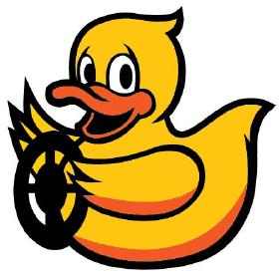
Imitációs tanulás a DuckieTown környezetben DAgger felhasználásával
Kovács Boldizsár - GVJY8E
Schneider Marcell - DBGYVI
Talpos Norbert - Q2H4XB
Virág József Ádám - U7KC0P

Slide 2
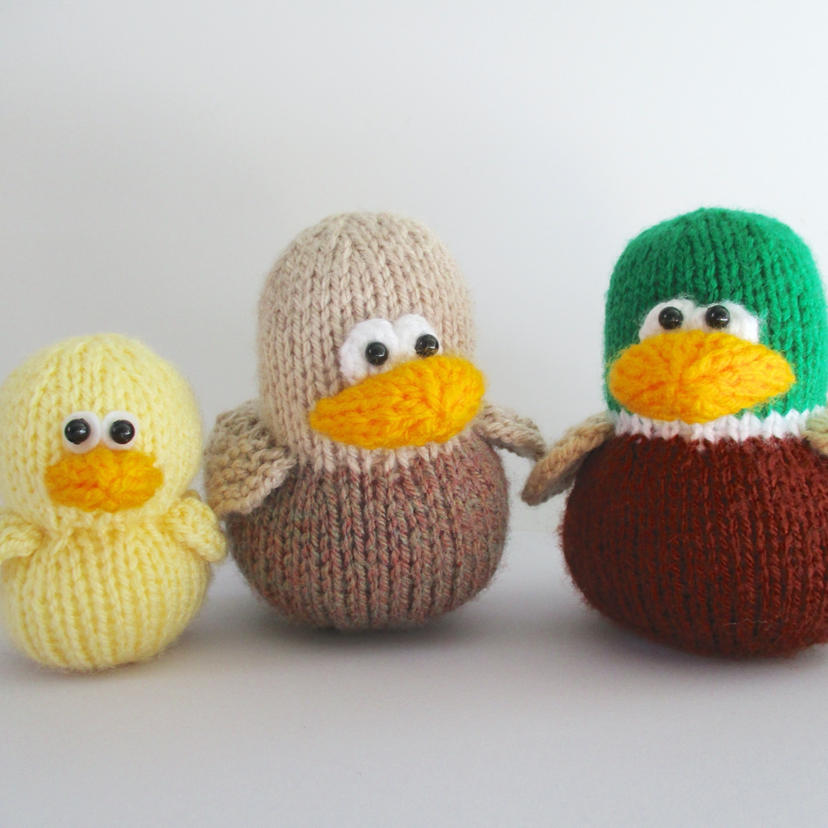
Introduction
Autonomous driving
Data collection, preprocessing
Imitation learning
DAgger
Hyper-optimization

Slide 3
Previous solutions
DAgger & other DAgger implementations
TDK (Lőrincz Zoltán)
DuckieTown documentation
Other DuckieTown projects

Slide 4
System design
Collecting some Data
Preprocessing
Training + Hyperopt.
DAgger

Slide 5
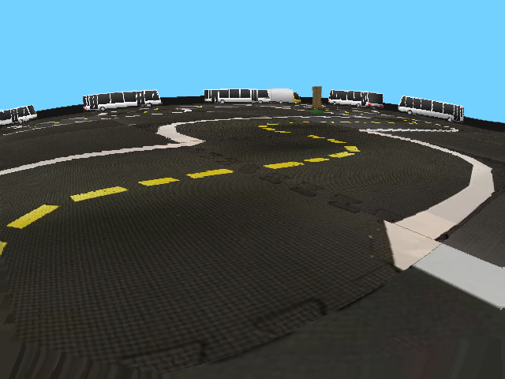
Database: generating and processing pictures
DuckieTown automatic driver
Manual driving using keyboard
Preprocessing:
HSV filtering: different colours
Cropping
Size reduction

Slide 6
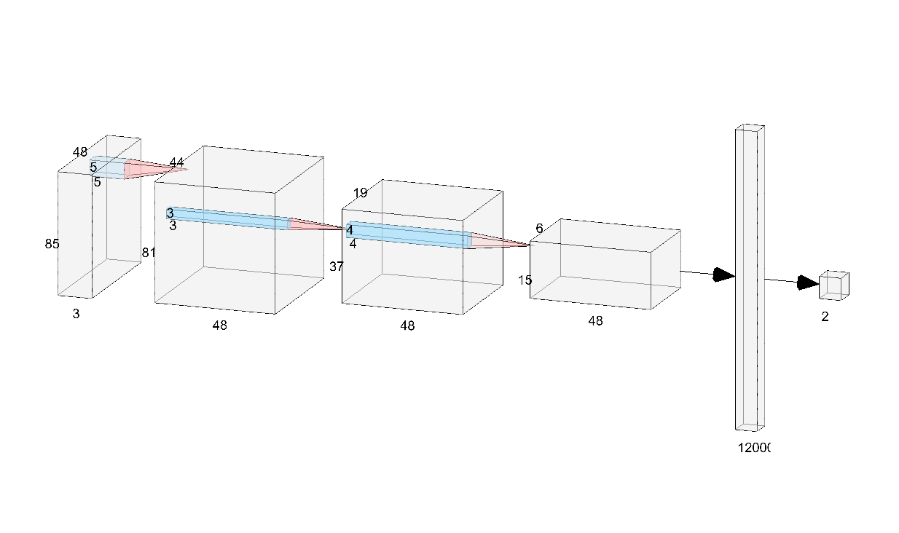
Architecture

Slide 7
Training, complications and solutions
Installing the environment
Constructing the model architecture
Implementing DAgger
Hyperoptimization
Training

Slide 8
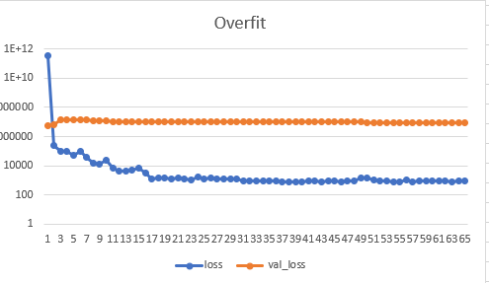
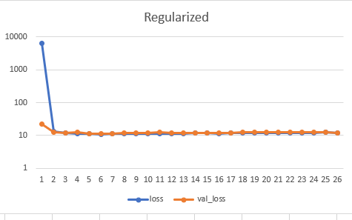
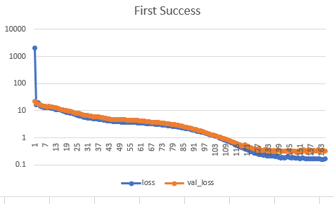
First Problems During Training
L1, L2
Dropout Layers

Slide 9
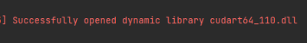
Training Challenges
Did Not Converge
CPU/GPU
Weird Results

Slide 10
Results and evaluation
Live Evaluation
Numerical Evaluation:
Steering , Velocity loss ~ 1
Similar to Validation loss
Not seen maps
velocity *= 1.6
steering *= 10

Slide 11
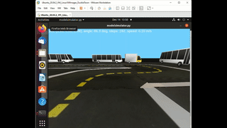
DEMO

Slide 12
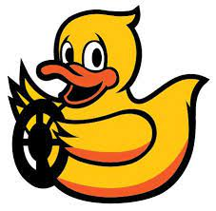
Thank you!

